Slide 1
CLASS AND OBJECTS
PRESENTED
BY
POTUKANUMA JEEVITHA

Slide 2
CLASS:-
A Class is a group of variables and methods.
A Class is like a Design /Blueprint to create objects.
Classes are reference types that hold the object created dynamically
in a Heap.
A Class consists of state and behaviour. State represent the properties
and Behaviour is the action that objects can perform.
The default access modifier of a class is Internal.
The keyword class is used in C# to declare a class.
SYNTAX:-
<access modifiers> class <ClassName>
{
// body containing variables and methods
}

Slide 3
OBJECT:-
An object is an instance of a class.
We can create any number of objects.
Objects occupy memory.
Objects are reference type.
Objects created using the new keyword.
SYNTAX:-
House h = new House ():

Slide 4
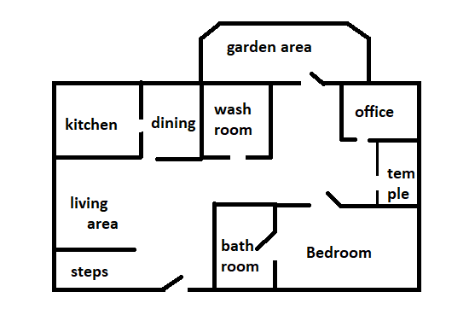
CLASS:
Blueprint for House

Slide 5
OBJECT:
VILLA
HUT
BUILDING

Slide 6

THANK.....
YOU

